Slide 1
Mechanical Testing of Slime Mold Algorithm Networks
By: Xerxes Zangeneh, Michael Yang

Slide 2
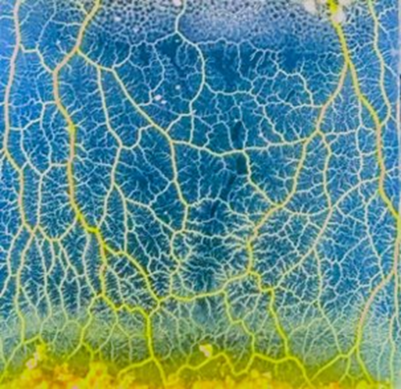
Background
Slime molds - Unicellular eukaryotes grouped together for expressing aneural cognition
Deciding direction, resource distribution, pruning
Used to mimic traffic and rail networks, and design strong network structures
Slime mold algorithm made based on meta-
heuristics, aggregate of food searching pattern

Slide 3
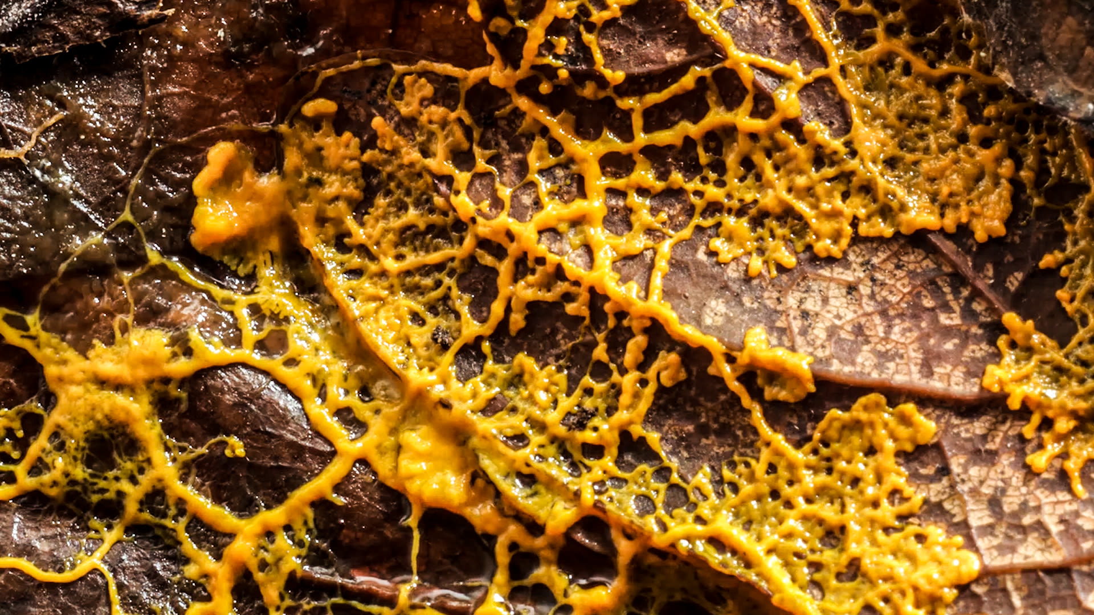
Background (cont.)
Slime molds are syncytium, like fungi, protists
Also spread through spores
Gliding motility much like fungi, amoeba
Different cell wall composition (cellulose vs chitin, silicates)
Don’t use hyphae, mycelium, exoenzymes
Genetically isolated, closest to amoeboid protozoa
https://www.wired.com/video/watch/mycologist-explains-how-a-slime-mold-can-solve-mazes

Slide 4
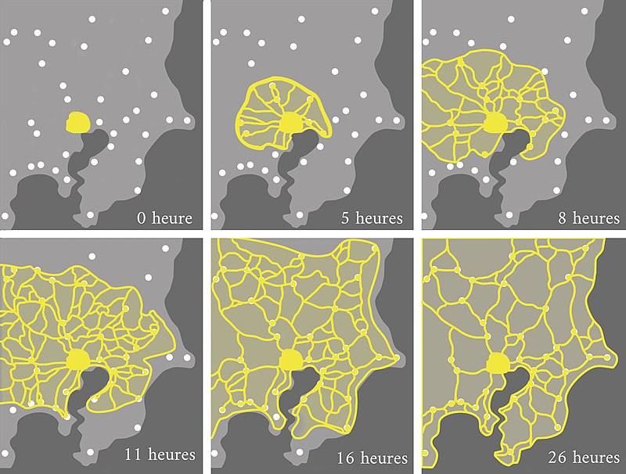
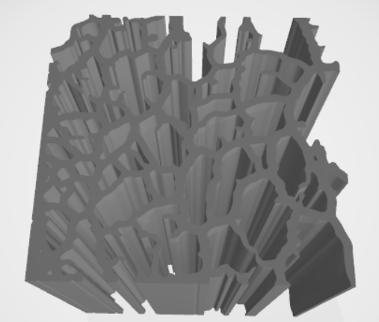
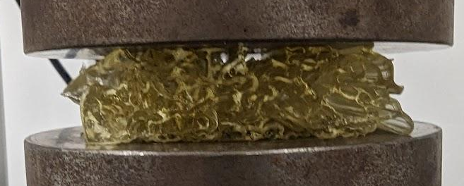
What Has Been Done
Traffic and train networks have similar constraints. Central nodes, distribution of resources between nodes, minimizing distance and reinforcing cross-linkages
Wang lab has imaged slime mold, converted and extruded through 3D printer to create network structures
Images from growing slime molds on plates can be replaced with models, more adjustable & accessible
Tero, A.; Takagi, S.; Saigusa, T.; et al. (January 2010). "Rules for biologically inspired adaptive network design" Science. 327 (5964): 439–442.

Slide 5
Objectives
Bio-design using slime mold networks to create load bearing structures. Testing shear deformation of networks through the use of LAMMPs
LAMMPS Uniaxial/Shear on Slime Network
Conversion of Networks
Image Algorithm Networks
Convert networks into dataset to be fed into LAMMPS
Change Node Density
Large gaps of empty space
More complete connection throughout
Choosing Node Locations
Areas of higher network connections

Slide 6
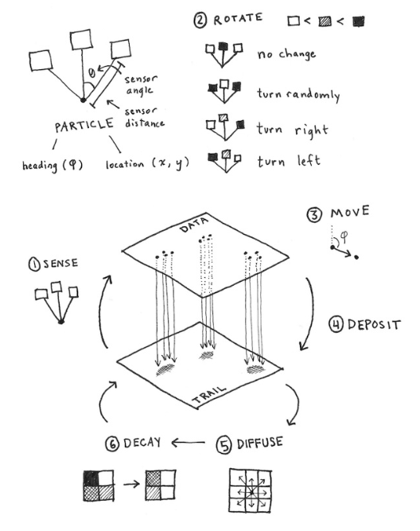
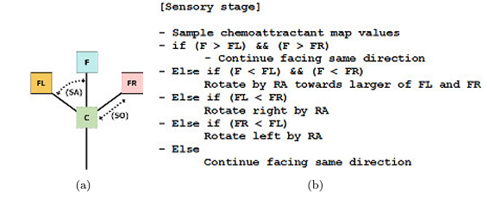
Network Algorithm
(Physarum)

Slide 7
Image to Dataset
Determine the node positions: Calculate the coordinates of the contours to identify the positions of the atoms
Determine connectivity: Find out which contours (atoms) are connected based on their proximity
Generate LAMMPS atom dataset: Translate the node positions and connectivity information into a LAMMPS-readable format

Slide 8
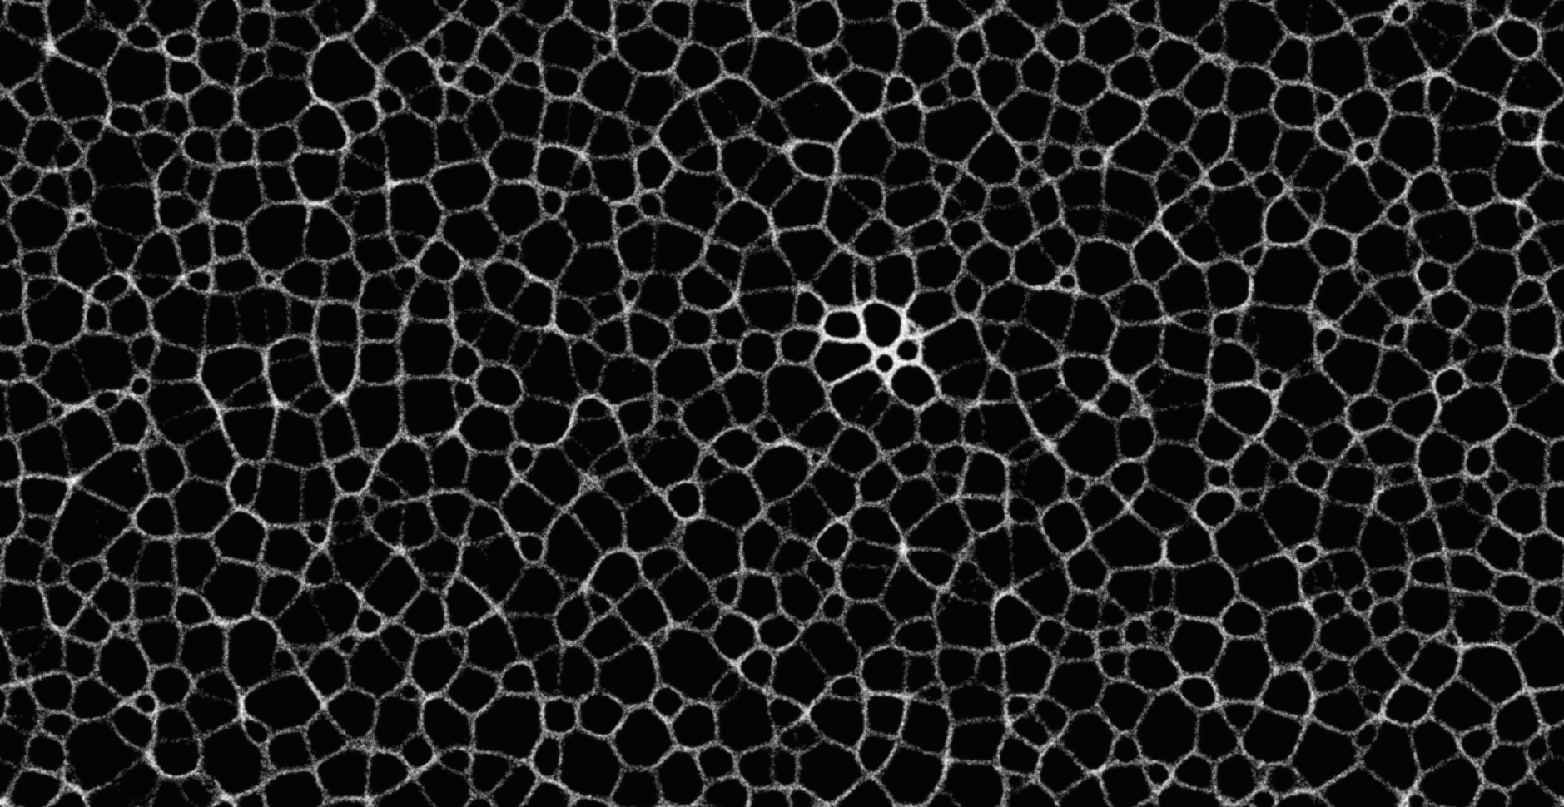
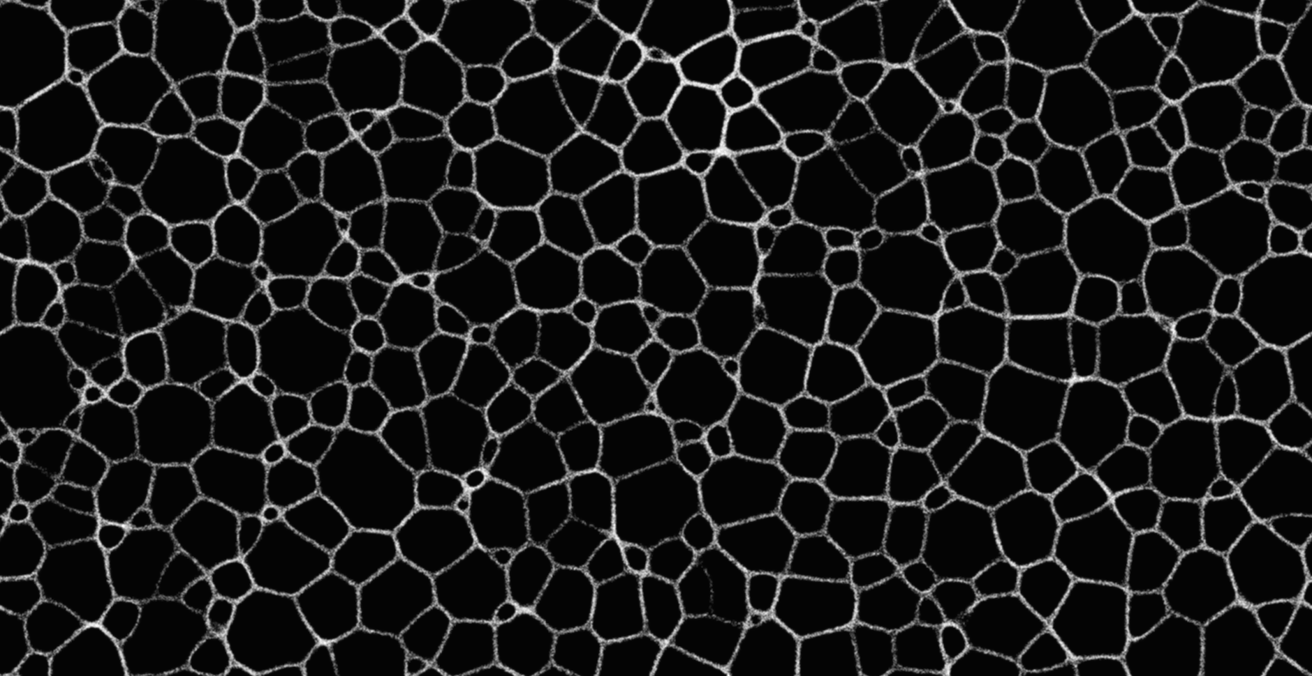
Methods: Uniform Random

Slide 9
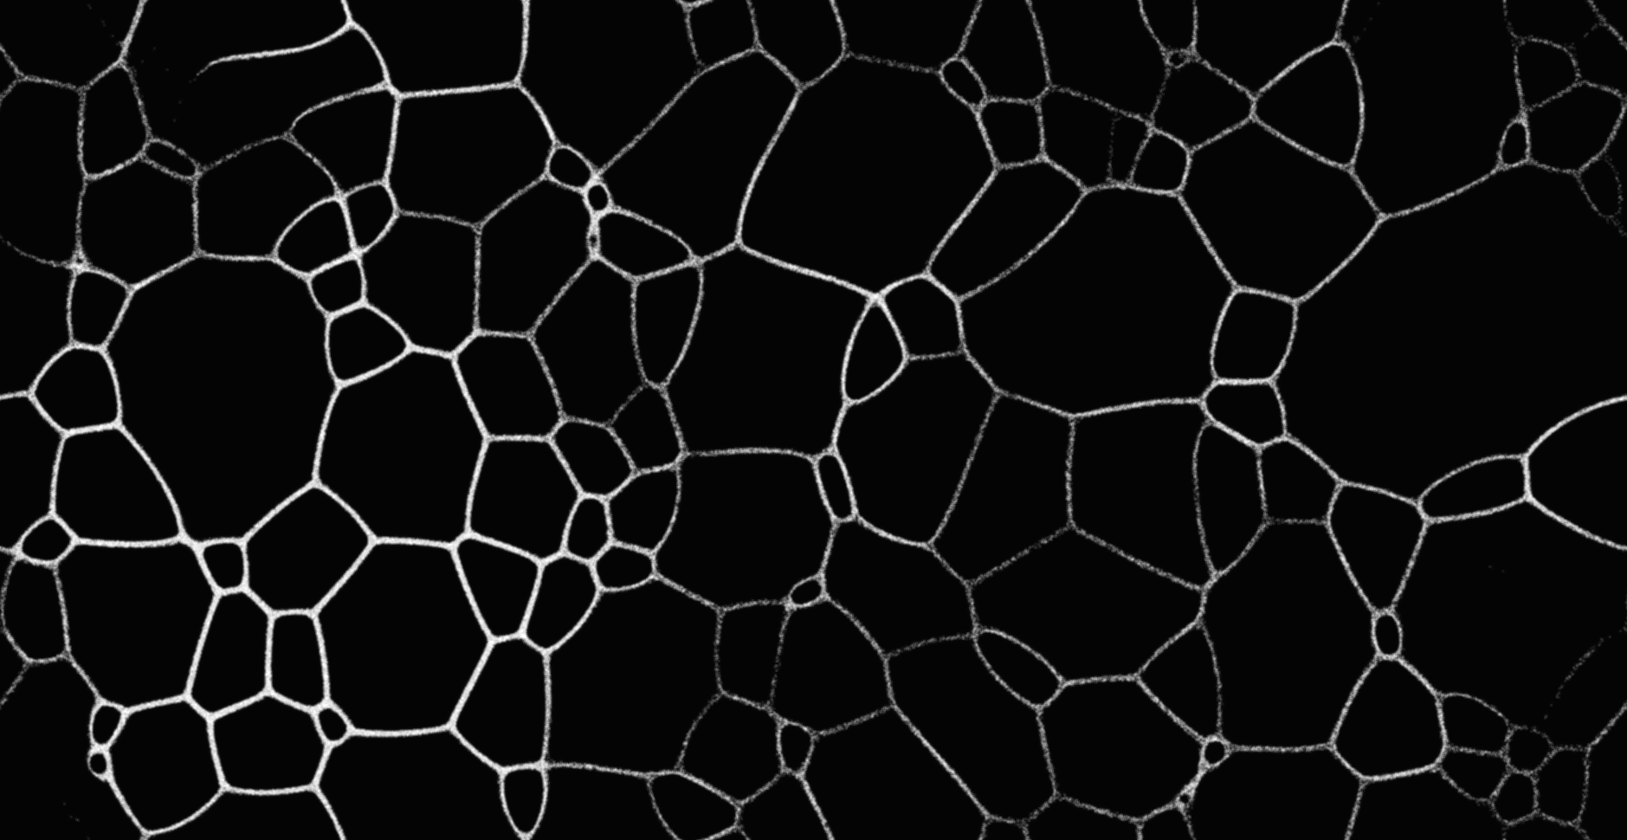
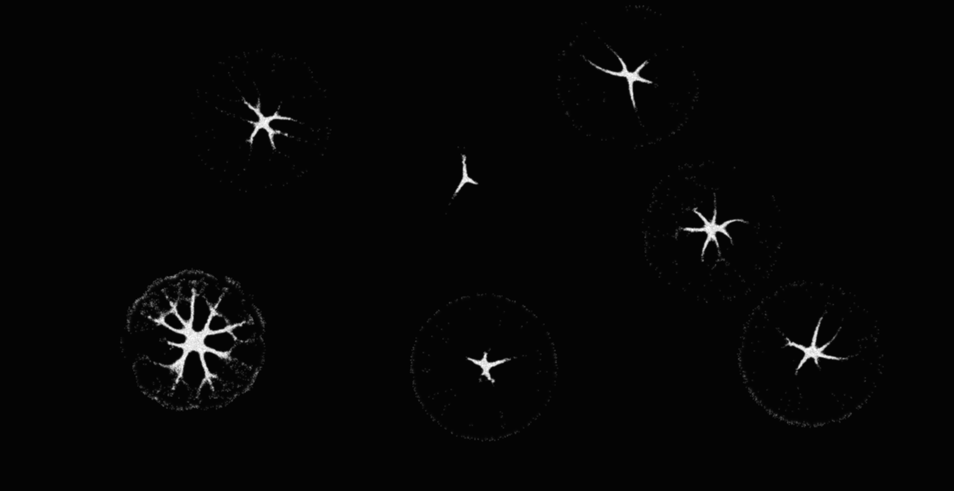
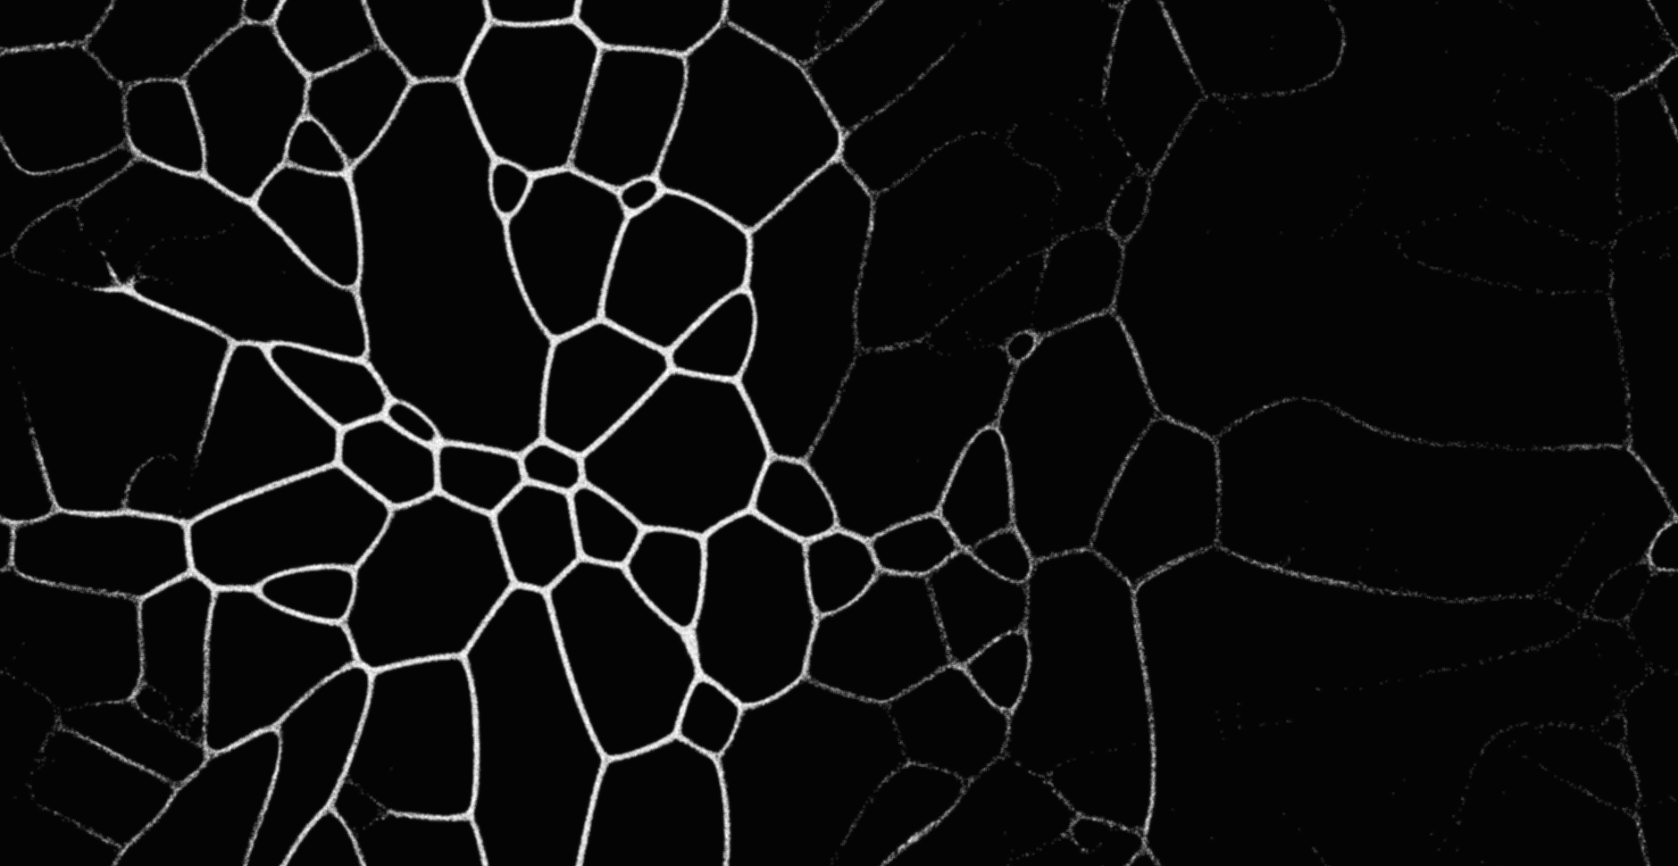
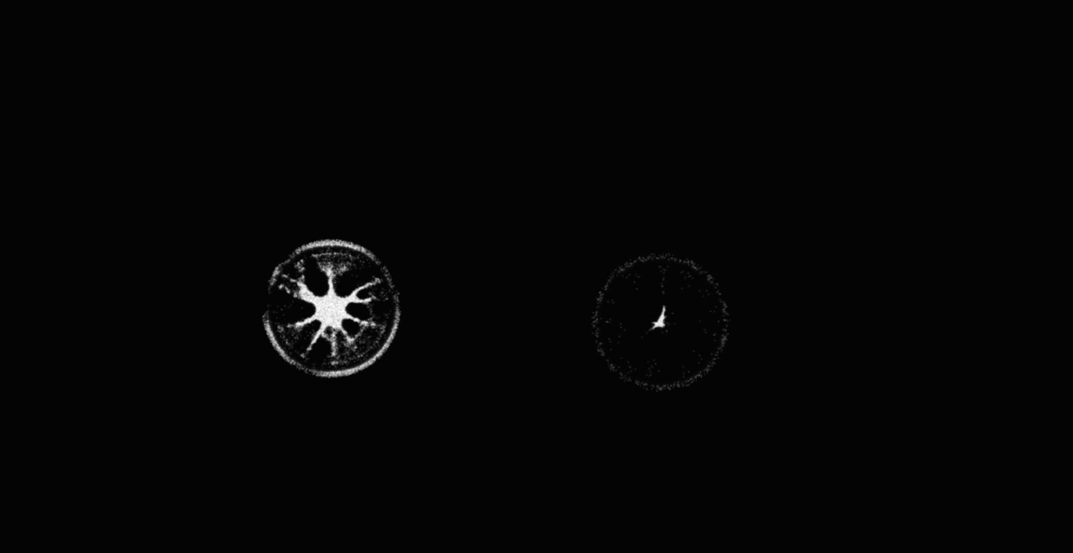
Methods: Initial Node Quantity

Slide 10
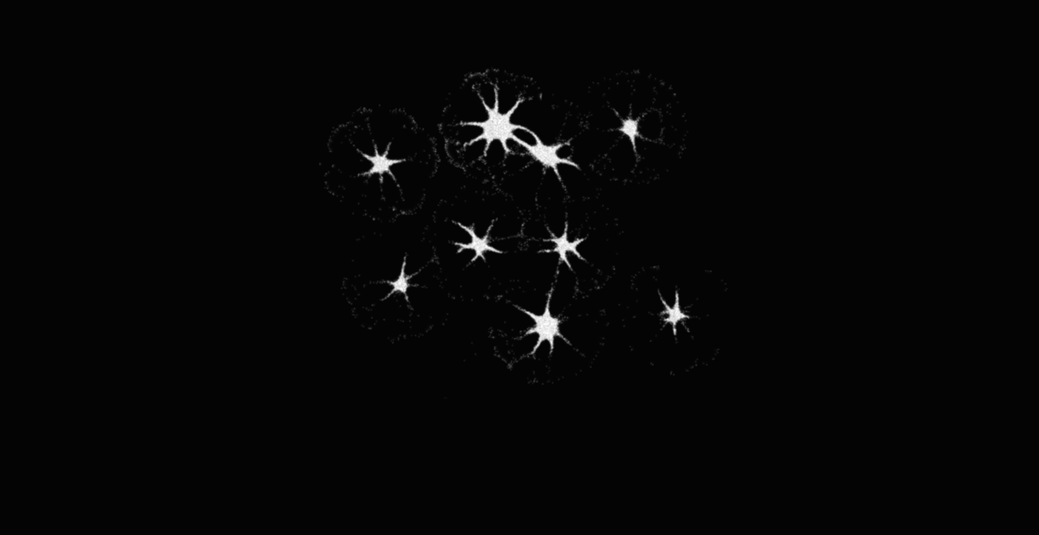
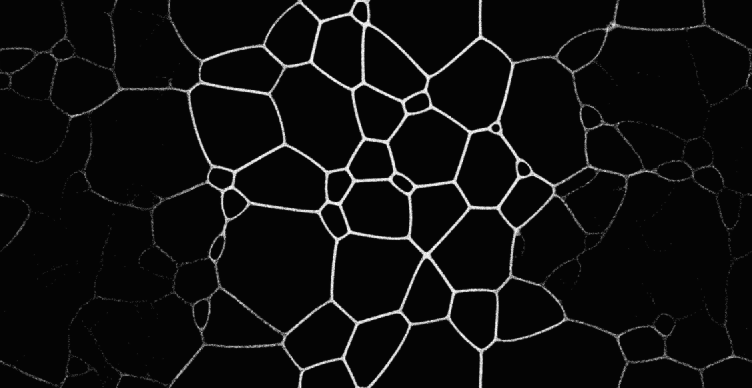
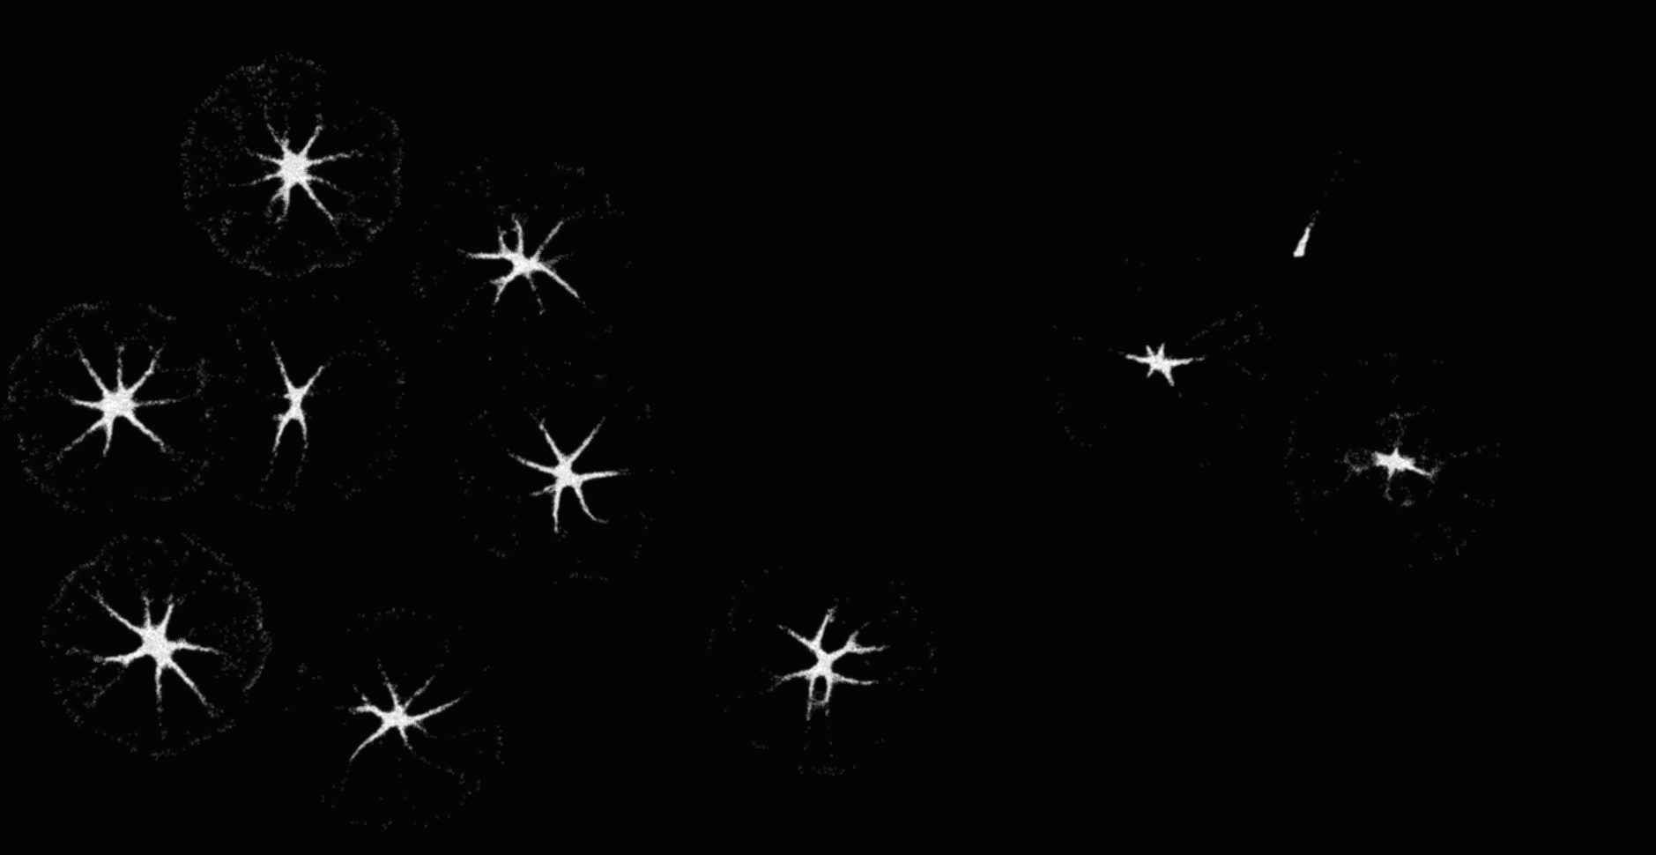
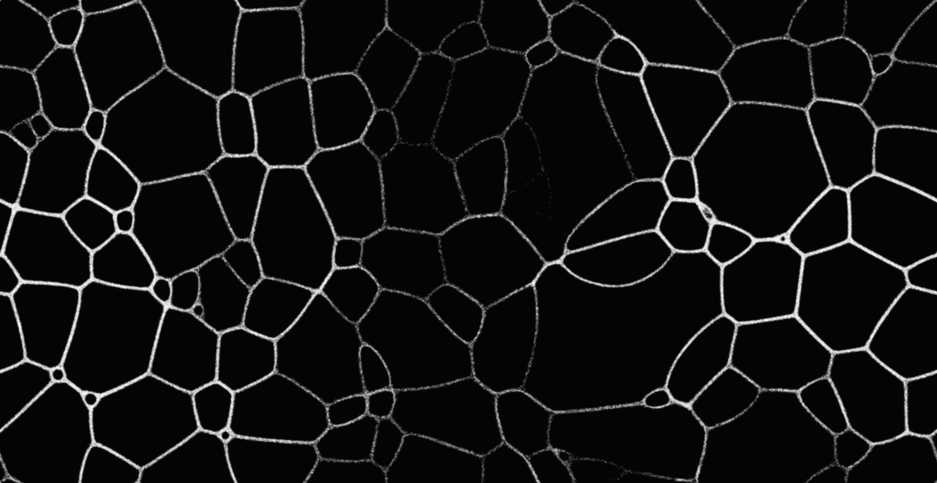
Methods: Choosing Node Locations

Slide 11
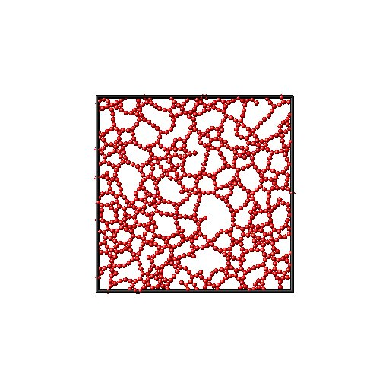
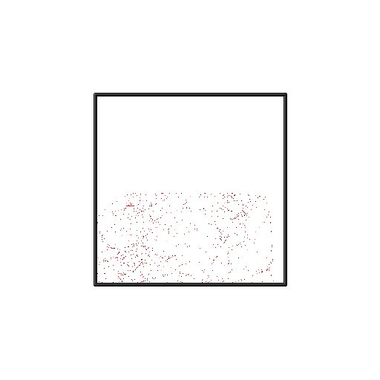
Results(Initial)

Slide 12
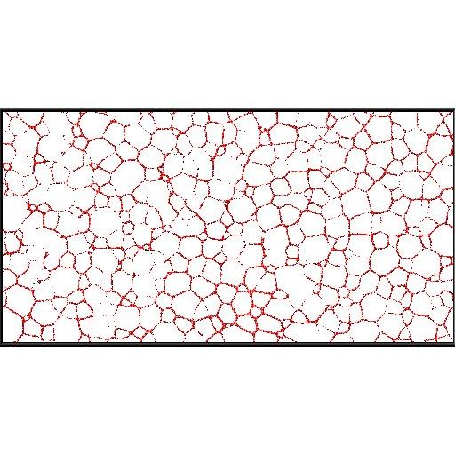
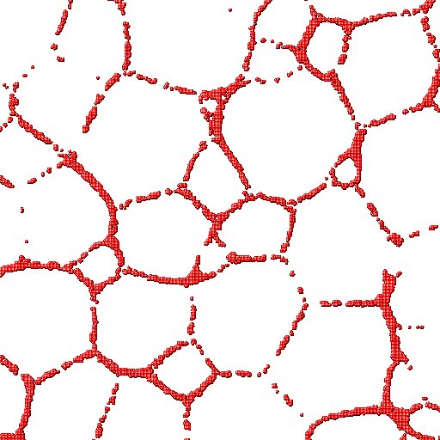
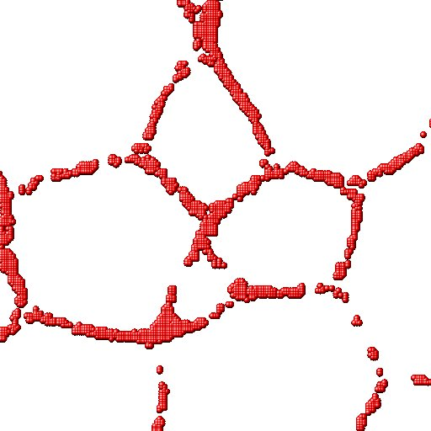
Results(Cont.)

Slide 13
Results(Cont.)
We were able to correctly format the image into a readable dataset by lammps
Looking at the images, there are too many atoms that make up the network connections
By changing values within the lammps script, we are able to see that the connections are actually made up of many atoms

Slide 14

Results(Cont.)

Slide 15
Future Plan
Use a higher scale model of slime mold growth to scale with Wang lab work
Find better construction mechanisms
Explore other slime mold algorithms

